Slide 1
Question 1
You are a skipper and also the licensee of commercial pleasure craft PC 1081 OL 14. Through which one of the following actions do you contribute to the safety and security of all persons onboard if your craft under charge of another skipper has been hired for a trip to Ilot Gabriel today?
A verifying that the only operational engine which is a 40 HP outboard motor is in perfect running condition
B giving clear instructions to the skipper that no more than 14 persons embark the craft including himself
C passing on to the skipper the times of high water and low water
D advising the skipper never to alter course to port in any situation at sea

Slide 2
Question 2
Which one of the following actions by a licensed skipper DOES NOT amount to an offence under the Tourism Authority Act 2006 ?
A failing to report an accident where his pleasure craft has sustained a damage within 24 hours to the Director of the Tourism Authority
B failing to give the name and address of the owner of the pleasure craft when so requested by an authorised officer
C operating a pleasure craft for private purposes when being only 16 years old
D operating a pleasure craft at a speed of 12 knots in the channel of Grand River South East

Slide 3
Question 3
While standing on the stem of a pleasure craft and facing aft at night, the sternlight shall
A be visual on your left hand side
B not be visual
C be visual on your right hand side
D be visual but green coloured

Slide 4
Question 4
Assuming a craft is at sea and her port side is receiving the wind. This side is referred to as
A the port leeward side
B the leeward side
C the port windward side
D the windward side

Slide 5
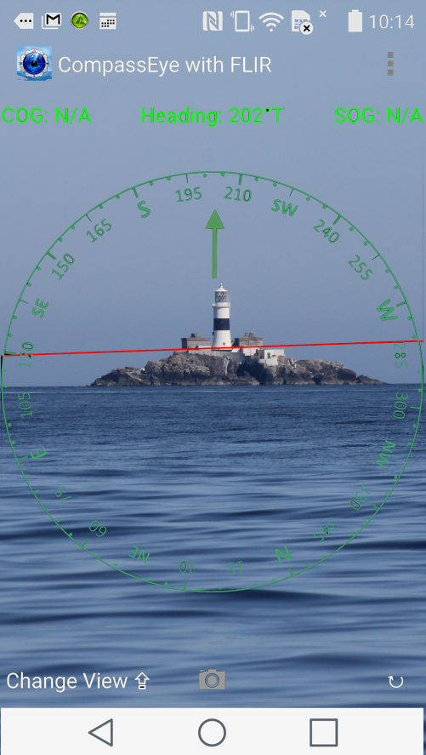
Question 5
You were heading on Ilot Benoit lighthouse by a gyro compass when suddenly the engine failed. You dropped the anchor and decided to call the NCG for assistance before attempting to rectify the defect. You would report the position of your craft as being
A west of Ilot Benoit lighthouse
B on bearing 022◦ T from Ilot Benoit lighthouse
C south west of Ilot Benoit lighthouse
D east of Ilot Benoit lighthouse

Slide 6
Question 6
Your pleasure craft is covering an average distance of 1.2 nautical miles within every 6 minutes. She is then proceeding at an average speed of
A 6 Knots
B 12 knots
C 18 knots
D 24 knots

Slide 7
Question 7
If your GPS is showing your position as
00◦ 23 '.123 N 000◦ 14'.701 E, your pleasure craft shall be
A in the southern hemisphere
B on a latitude which is 23.123 nautical miles south of the equator
C in the northern hemisphere and east of the Greenwich Meridian
D on a longitude which is west of the Greenwich Meridian subtending an angle of 14.701 minutes at the centre of the earth

Slide 8
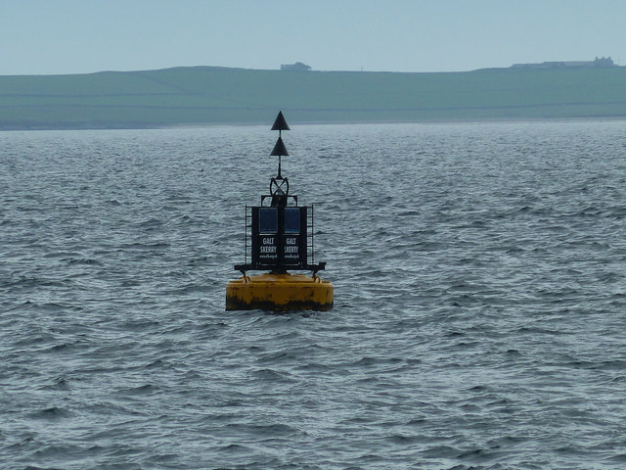
.
Question 8
You are steering 260 ◦C at 12 knots and you notice this buoy right ahead of you at a distance of about 500 metres. As a competent skipper, which manoeuvre will you carry out?
A slow down and alter course to 200 ◦ C
B increase speed up to 16 knots and pass not less than 50 metres downwind.
C slow down and alter course to 320 ◦ C
D slow down and pass close enough to the buoy but downwind
WIND

Slide 9
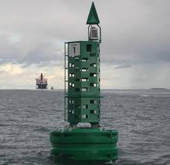
Question 9
Which statement in respect of this buoy is FALSE?
A It cannot be seen on high seas
B It has a top mark which is painted black
C It is one of the two lateral buoys
D It is to be left on your port side when proceeding to high seas from a harbour

Slide 10
Question 10
Spring tides are characterised by
A only one HIGH WATER in 24 hours
B higher LOW WATERS and lower HIGH WATERS
C higher HIGH WATERS and lower LOW WATERS
D weak tidal currents in and out of passes

Slide 11
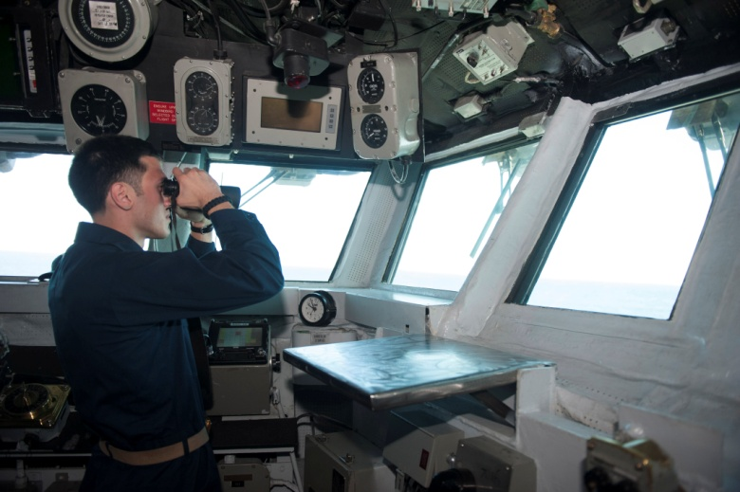
Question 11
This sailor is assisting in the safe navigation of the ship by
A ensuring that the ship is following the correct course
B advising the Deck Watch Officer as to when to alter course to prevent a collision
C reporting presence of other ships or dangers so that the Deck Watch Officer can assess if there is risk of collision
D reporting changes in the weather conditions

Slide 12
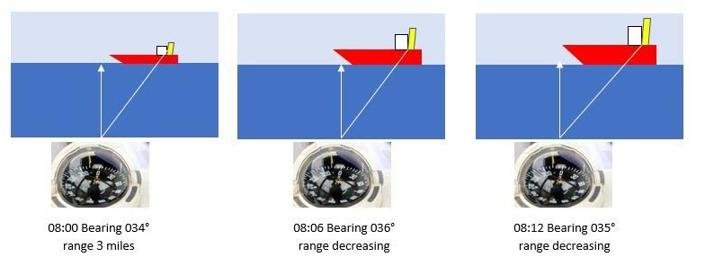
Question 12
Based on the above scenario, it can be deduced at 0812 h that
A vessel B will pass ahead of vessel A without any risk of collision
B vessel B needs to sound two short blasts and alter course to port to pass astern of vessel A
C there is high risk of collision
D vessel A can maintain her course and speed
B
B
B
A
A
A
Range 2.5 miles
Range 2.0 miles

Slide 13
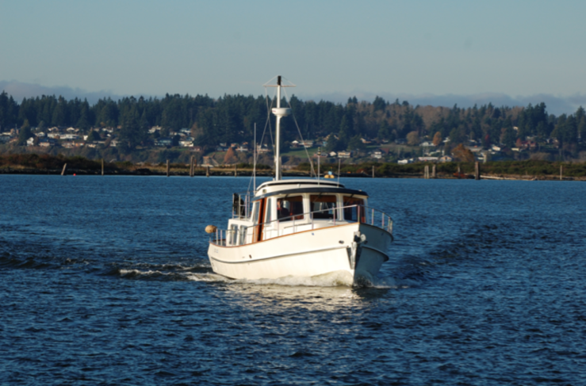
Question 13
This power-driven vessel is 5 degrees off your starboard bow and is maintaining her course and speed. There is risk of collision. What is the best action to be taken to avoid the collision?
A sound one short blast and alter course to starboard by at least 60 degrees
B sound two short blasts and alter course to port by at least 60 degrees
C sound three short blasts and engage astern propulsion
D sound at least five short and rapid blasts and let go the anchor

Slide 14
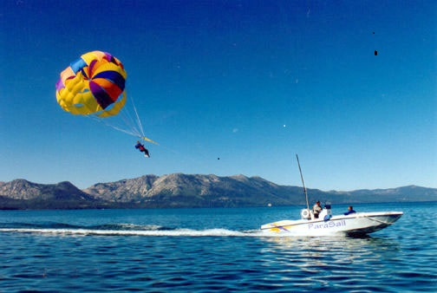
Question 14
This power-driven vessel is engaged in parasailing activity and is off your port bow at a distance of about 200 metres. There is risk of collision. Which one of the following statements is FALSE in respect of this situation?
A the parasailing vessel has right of way
B your vessel is the stand on vessel
C you need to sound two short blasts and alter course to port
D the parasailing vessel is restricted in her ability to manoeuvre

Slide 15
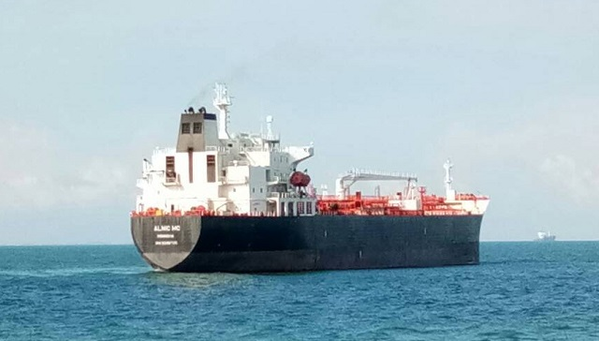
Question 15
This tanker is right ahead of you and distance is gradually decreasing. There is risk of collision. It follows that
A you have to sound three short blasts and alter course to port
B you are the overtaken vessel
C you should take action to prevent a collision
D you cannot alter course to starboard

Slide 16
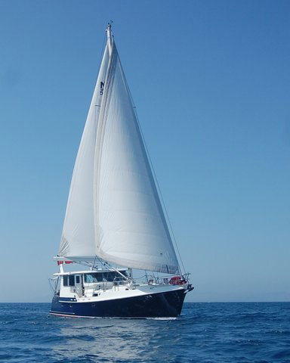
Question 16
This sailing vessel is off your port bow and you cannot make out if she is also being propelled by engine. She is maintaining her course and speed and there is risk of collision. What is the best action to be taken being given you are operating a power-driven vessel?
A sound three short blasts and engage astern propulsion
B sound two short blasts and make a bold alteration of course to starboard to keep well clear of her
C sound two short blasts and make a bold alteration of course to port to keep well clear of her
D increase speed and pass ahead of her

Slide 17
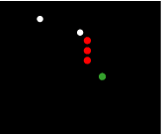
Question 17
These lights are visual to you at night at a distance of 2 nautical miles off your port bow. There is risk of collision. What is the best action to be taken to avoid a collision?
A alter course to port by at least 60 degrees to pass astern of her
B alter course either to port or to starboard because she is aground
C alter course to starboard by at least 60 degrees since she is at anchor and engaged in some work
D stop engines and engage astern propulsion

Slide 18
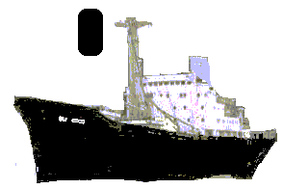
Question 18
This vessel is showing a black cylinder by day . It means that she is
A at anchor
B aground
C restricted in her ability to manoeuvre
D constrained by her draught

Slide 19
Question 19
What is the recommended angle of approach when manoeuvring a craft to come alongside a jetty ?
A 15 degrees
B 30 degrees
C 45 degrees
D 60 degrees

Slide 20
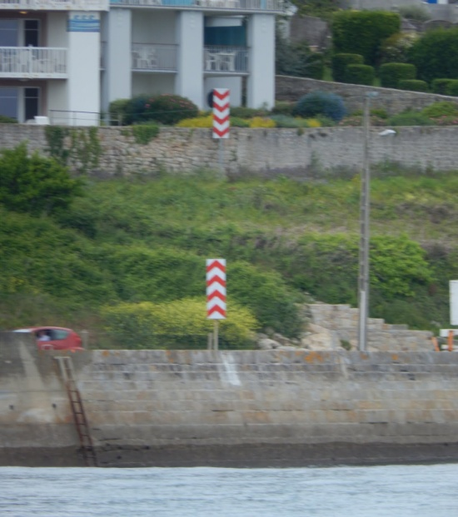
Question 20
You are entering a harbour keeping these two leading marks in transit on course 032◦ C. Because of tidal current, some minutes later you find that the front leading mark has ‘moved’ to the left. It follows that
A your craft is port of track
B you should steer a course higher than 032◦ C to regain track
C you should steer a course lower than 032◦ C to regain track
D you have to reverse course and start your approach anew

